Slide 1



1. REQUIREMENTS ANALYSIS
1: REQUIREMENTS ANALYSIS
3:. NON-FUNCTIONAL REQUIREMENTS
The following is high-level requirement for the developer competition based on the concept design.
<<Requirement>>
Efficient Development Structure
Requirements are further broken down into functional and non-function requirements.
<<Requirement>>
Goal: Get – 15 seconds total for Developer competition
<<Requirement>>
Configuration Management
<<Requirement>>
Parallel Development Process
<<Requirement>>
Efficient Development Process
<<Requirement>>
Efficient Verification Process
<<Requirement>>
Efficient Development Process
<<Requirement>>
Excellent model documentation
<< Requirement>>
Not disqualify
<<Requirement>>
Successful
BASIC STAGE
------GOAL------
IN: 10 Seconds
OUT: 20 Seconds
<<Requirement>>
Successful
BONUS STAGE
----- GOAL ----
IN: -20 Seconds
OUT: - 20 Seconds
Use of SVN
Use of Simulink Projects
<<Requirement>>
Use Model-Based Design process
<<Requirement>>
Use Rapid-Prototyping process
<<Requirement>
Use a tool to log test signals for verification
2: FUNCTIONAL REQUIREMENTS
2.3
Use of MATLAB & Simulink
Use of Simulink Target Hardware Support Package
Develop and use Bluetooth data logging tool
2.5
2.6
DS
DL
<<Requirement>>
Successful
PARKING
----- GOAL ----
IN: - 5 sec
<<Requirement>>
Successful
REMOTE START
----- GOAL ----
IN: - 5 sec
<< Requirement>>
Complete Developer Competition
within 2 mins
<< Requirement>>
No Interfere with opponent’s robot
<<Requirement>>
Successful
INNER TRACK
---- GOAL ----
@ less than 35 sec
Total: 35-25 = 10 sec
<<Requirement>>
Successful
OUTER TRACK
---- GOAL ----
@ less than 50 sec
Total: 50-30 = 20 sec
<<Requirement>>
Successful
DOUBLE SEESAW
----- GOAL ----
IN: - 10 sec
<<Requirement>>
Successful
DOUBLE LOOKUP
----- GOAL ----
OUT: - 10 sec
<<Requirement>>
Minimize time to finish basic stage.
Goal: < 50 seconds
<<Requirement>>
Finish the BONUS STAGE within
1 min
<<Requirement>>
Clear Zone 1, 3, 4 and 5.
----- GOAL ----
IN: - 25 sec
<<Requirement>>
Clear Zone 1, 2, 3, 4 and 5.
----- GOAL ----
IN: - 30 sec
<<Requirement>>
Able to enter double seesaw successfully
<<Requirement>>
Able to exit seesaw successfully
<<Requirement>>
Clear
LOOKUP GATE
<<Requirement>>
LINE-TRACKING with tail up
<<Requirement>>
LINE-TRACKING with tail down
Element Technologies
Blind run for shortcut
Ambient Light Elimination
Switching PID Parameters
Current Angle Estimation
Speed Control
Step Detection
Step-off Ramp Detection
Turn 180 degree
Tail Control
Encoder Distance
Bluetooth communication
$$φ$$
Please refer to following sections for details.
5.1
5.1.A
5.1.B
5.2
5.1
5.4
5.4
5

Slide 2


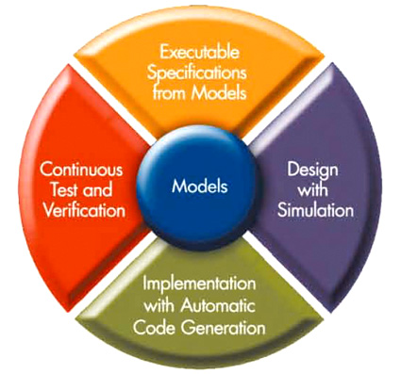
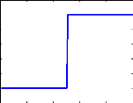
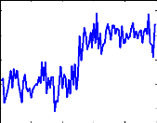
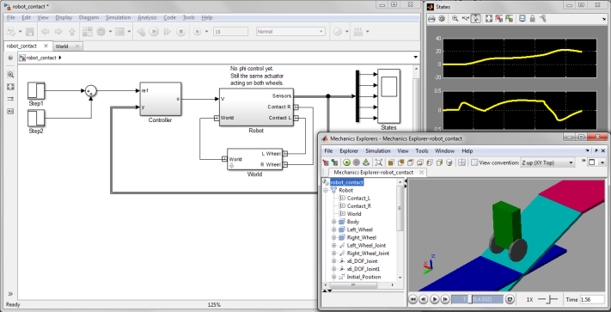

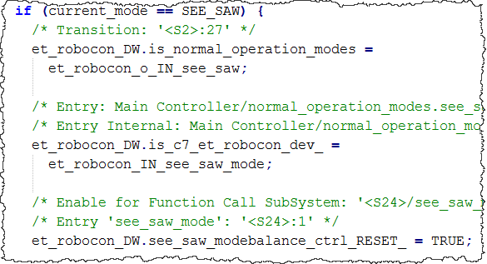

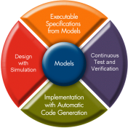
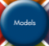
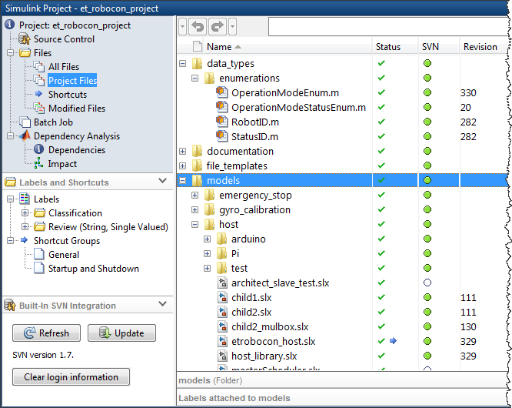
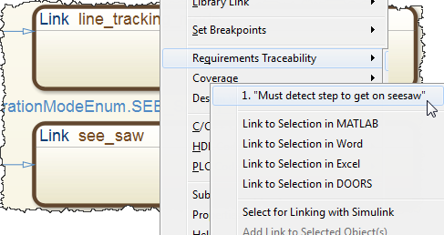
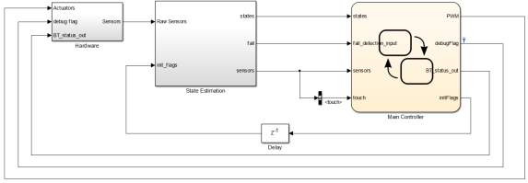
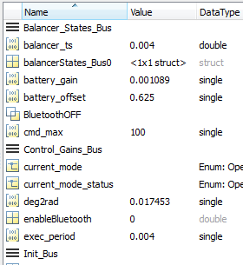
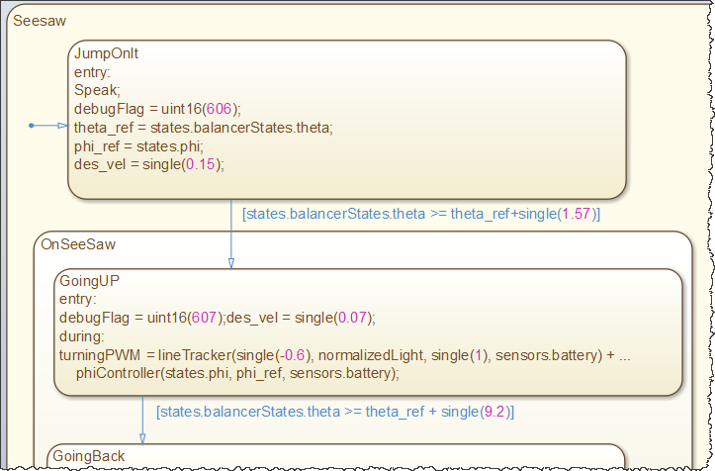
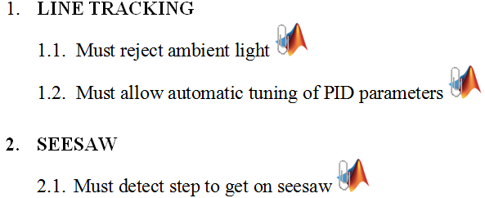
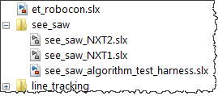
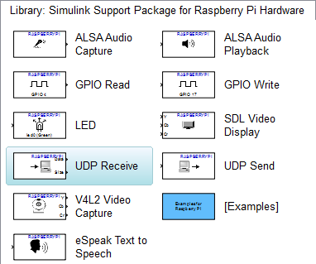
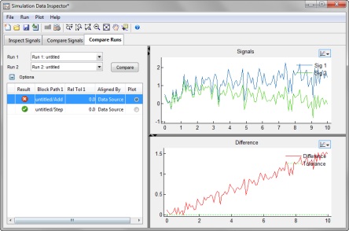
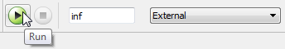
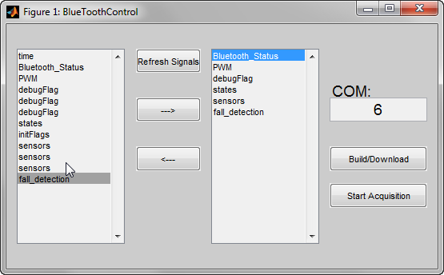
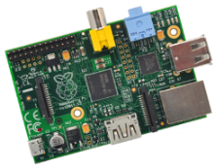

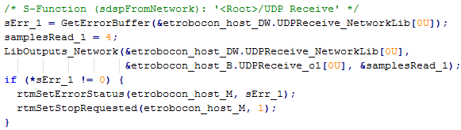
2. DEVELOPMENT PROCESS AND TOOLS
1: DEVELOPMENT ENVIRONMENT
2: MODEL-BASED DESIGN
We can perform Component-level design of control algorithms and test them by creating artificial inputs in Simulink.
The Model-based Design (MBD) approach is centered around a model of a real system.
All design changes can happen at the model level. All associated tasks can be easily updated with the changes to the model.
We use the MATLAB and Simulink environment throughout the entire development process.
These tools facilitate:
Requirements linking
System-level design
Model architecture
Configuration management
Data management
Algorithm Design
Rapid Prototyping
Verification and Validation
SYS1
Then, we can perform System-level integration to test the performance of algorithms in the entire system.
We can create a physical model of the LEGO Mindstorms NXT and test our control algorithm design in simulation.
SYS0
SYS1
SYS2
SYS3
Finally, we can automatically generate code from these models onto embedded systems and verify the algorithm behavior.
Accelerating the pace of engineering and science.
Simulink Model
C Code
3: PROJECT MANAGEMENT
Requirements can be linked to Simulink models using the Simulink Verification and Validation product.
4: SIMULINK MODEL MANAGEMENT
Stateflow for modeling complex control logic using flow graphs and state machines,
Models are represented by using Simulink block diagrams.
Requirements
document
MATLAB files
Model
Simulink libraries and model reference help with concurrent development in separate files.
Simulink models
Link
We promote concurrent model development by using Subversion (SVN) for source control. Simulink Projects is used to integrate SVN into the MATLAB environment.
Main model
Data dictionaries and model variants to store, modify and switch model configurations.
Library models
(dependencies)
5: RAPID PROTOTYPING
6: MODEL TEST AND VERIFICATION
External mode:
Visualize data
Tune parameters
while a model is running on embedded hardware.
We can automatically generate code from Simulink models and build them onto low-cost embedded systems using Simulink Support Packages for Target Hardware.
This enables us to reuse simulation algorithms and automatically build them on the performance embedded devices:
LEGO Mindstorms NXT
Arduino Mega 2560
Raspberry Pi
Bluetooth data logging:
Custom tool to collect sensor, state and logic data while running a model on embedded hardware.
Select signals for logging
Run-time Display
Tune parameters
Model
(Host PC)
Hardware
Simulink Library:
Contains driver blocks
Receive run-time data
View and compare runs in Simulation Data Inspector
C Code
Embedded target communicates with host computer using TCP-IP over USB.

Slide 3
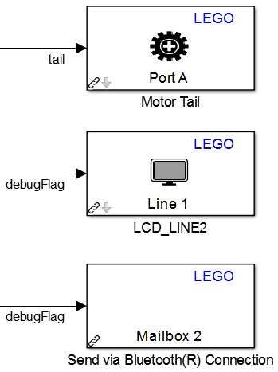
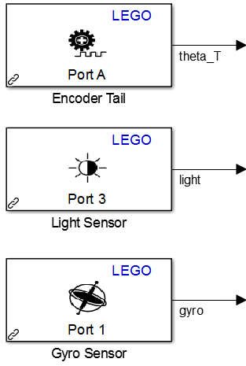
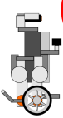
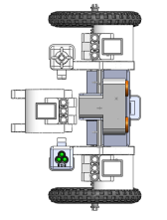
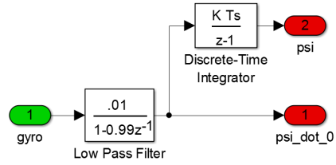

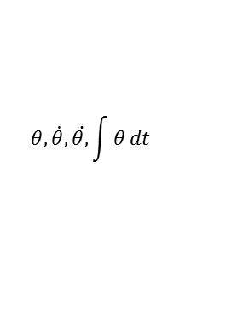
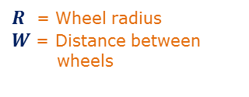
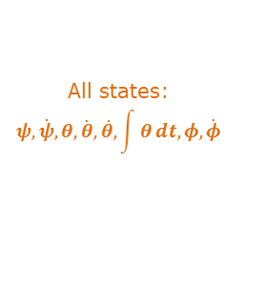














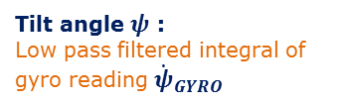

3. NXT MODEL ARCHITECTURE
1: MODEL OVERVIEW
Simulink® model built on LEGO Mindstorms NXT
2: HARDWARE
Simulink Model
Create RXE File
et_robocon.slx
Robot sensors and actuators are accessed through the Simulink Support Package for LEGO Mindstorms NXT.
Generate C Code
GNU ARM
toolkit
$$\hat{x}$$
C
Automatic code
generation
Automatic build and download through Cygwin
Hardware
I/O
State
Estimation
Controller
Actuators
Motor PWM
LCD debug display
Bluetooth send
Utilities in controller
Line Track
Balance
DS
DL
…
Double Seesaw
Double Lookup Gate
Sensors
Motor encoders
Light/Gyro/Ultrasonic
Buttons
Battery
Bluetooth receive
Tasks
Each task is developed independently and placed in a separate project folder under source control
Generated code translates Simulink driver blocks into nxtOSEK functions
3: STATE ESTIMATION
$$\hat{x}$$
4: CONTROLLER
C
C. Task Management:
Tasks are executed using a Track Mode List.
This is a vector of OperationModeEnum enumerated data type.
Each task outputs its status. This is done with an enumeration of type OperationModeStatusEnum.
Converts sensor values into states. States used for balancing and line tracking.
A. Control Logic:
Unless there is an emergency, the controller will execute all defined tasks sequentially.
GYRO READINGS
${\dot{ψ}}_{GYRO}$ = Robot tilt rate
$$ψ, \dot{ψ }$$
$R$ = Wheel radius
$W$ = Distance between wheels
Normal Operation
ENCODER READINGS
$θ_{L}$ = Left motor angle $θ_{R}$ = Right motor angle
start
Do Task
start
entry:
start task
exit: next task
Example Track Mode List: 1. LIGHT_CALIBRATION_UP 2. GYRO_CALIBRATION
$$φ, \dot{φ}$$
Read Gyro
Read
Encoders
$$θ,\dot{θ},\ddot{θ},\int{θ}dt$$
task complete
3. LINE_TRACKING
$${\dot{ψ}}_{GYRO}$$
$$θ_{L},θ_{R}$$
Side view
Top view
task aborted or robot falls
E-Stop
start
Start
Filter and compute
$$ψ$$
Tilt angle $ψ$ : Low pass filtered integral of gyro reading ${\dot{ψ}}_{GYRO}$
entry: stop moving
push
button
entry: start moving
Status = IN_PROGRESS
$$ψ,\dot{ψ}$$
Compute
$$θ \text{and} φ$$
B. Task Component:
Each task must interface with the main controller using the following specification.
end of line
lost line
Finish
Failure
$$θ,φ$$
Controller
entry: stop moving
Status = COMPLETED
entry: stop moving Status = ABORTED
Compute other states
Turning angle $θ$ and Steer angle $φ$ :
Task
interface
$$θ=\frac{1}{2}\left(θ_{L}+θ_{R}\right)+ψ$$
$$\hat{x}$$
Inputs
States
Sensors
Task
Component
Outputs
Motor PWM
Bluetooth command
Task status
Sensor initialize flags
Debug flags (for LCD)
To next task
To E-Stop
All states:
$$ψ,\dot{ψ},θ,\dot{θ},\ddot{θ},\int{θ}dt,φ, \dot{φ}$$
$$φ=\frac{R}{W}(θ_{R}−θ_{L})$$
4. SEE_SAW
5. PARKING
If the final task is marked complete, the robot will loop back to the first task.
All state estimation integrals are reset to zero using initialize flags from the controller.

Slide 4
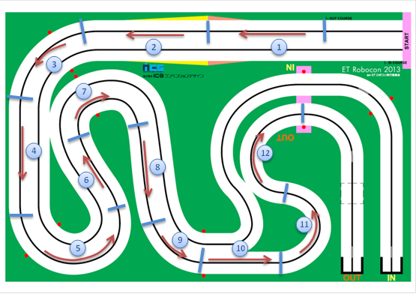
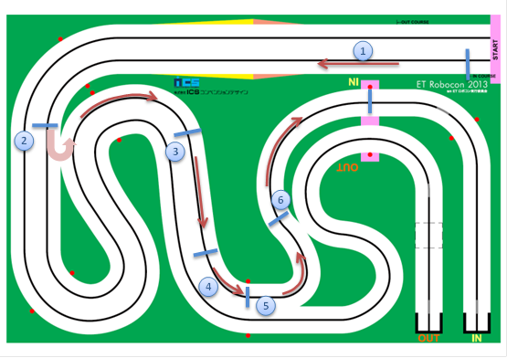
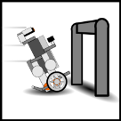
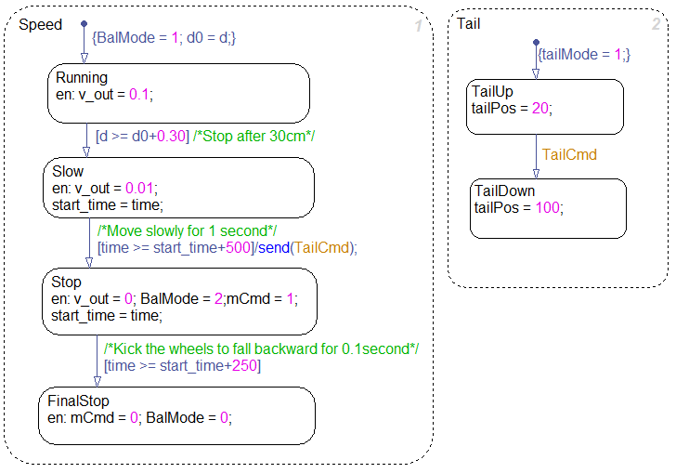

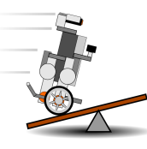
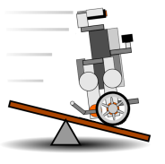
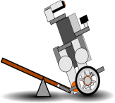

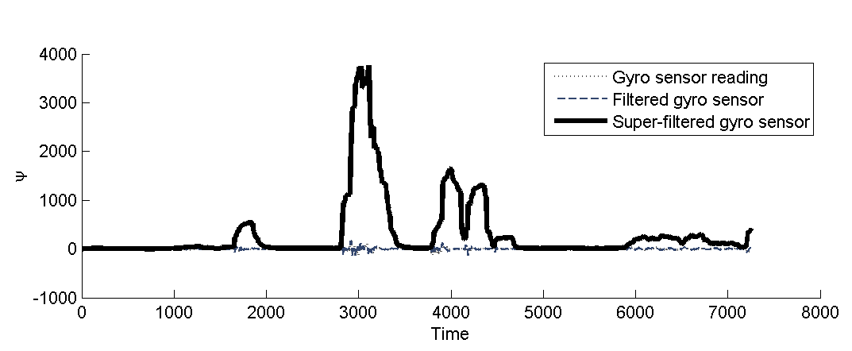



4. DRIVING STRATEGY
1: BASIC STAGE
$$φ$$
3: LOOK-UP GATE (DOUBLE)
DL
$$φ$$
A: OUTER TRACK STRATEGY
B: INNER TRACK STRATEGY
SONAR
I. NXT Robot Senses look-up gate with sonar
TAIL
CONTROL
II. NXT Robot slowly leans back on tail
III. Line tracking under the gate
SHORT CUT
Repeat
TAIL
CONTROL
IV. NXT Robot quickly stands up on tail
Zone | Speed (rad/sec) | PID Gain Parameter | Mode Description
1 | 120 | PID_Gain_Straight | Normal speed for up ramp
2 | 140 | PID_Gain_Straight | Full speed for straight line tracking
3 | 120 | PID_Gain_Fast_Curve | Reduced speed for wide curve
4 | 140 | PID_Gain_Straight | Full speed for straight line tracking
5 | 120 | PID_Gain_Fast_Curve | Reduced speed for wider curve
6 | 140 | PID_Gain_Stright | Full speed for straight line tracking
7 | 80 | PID_Gain_Slow_Curve | Low speed for tight curve
8 | 140 | PID_Gain_Straight | Full speed for straight line tracking
9 | 120 | PID_Gain_Fast_Curve | Reduced speed for wider curve
10 | 140 | PID_Gain_Straight | Full speed for straight line tracking
11 | 100 | PID_Gain_Fast_Curve | Medium speed for half circle turn
12 | 120 | PID_Gain_Fast_Curve | Reduced speed for wider curve
Zone | Speed (rad/sec) | PID Gain Parameter | Mode Description
1 | 120 | PID_Gain_Straight | Normal speed for up ramp
2 | 100 | PID_Gain_Shorcut | Short cut, No Line Tracking
3 | 140 | PID_Gain_Straight | Full speed for straight line tracking
4 | 120 | PID_Gain_Fast_Curve | Reduced speed for wider curve
5 | 100 | PID_Gain_Slow_Curve | Reduced speed for tight curve
6 | 120 | PID_Gain_Fast_Curve | Reduced speed for wider curve
$$φ$$
V. Turn around based on encoder angle estimate
C: SHORT CUT - OUTER TRACK (ZONE 2)
SONAR
VI. Sense look-up gate with sonar
DETECT SHORT CUT – detect location using distance travelled. (Encoder Value)
U-TURN – Turn off line-tracking then make a 180 degree turn.
LINE SEARCH – perform line search via slowly approaching from right side of the line.
Repeat until gate has been passed 3 times
(double look-up gate)
2: SEESAW (DOUBLE)
DS
$$φ$$
4: PARKING
$$φ$$
A: GYRO SENSOR DATA ANALYSIS
B: SEESAW STRATEGY
Perform test and gather data from gyro sensor when robot:
- Approaches and detects seesaw
- Rides off the seesaw
Summary: Balancing with two wheels and controlling balancing of NXT robot on see-saw using the gyro sensor readings.
Data logging using Bluetooth logging tool
$$φ$$
$$φ$$
$$φ$$
$$φ$$
I. NXT Robot Detects Edge of seesaw
II. NXT Robot on seesaw
III. Tip Back Seesaw
IV. Goes forward
V. Off seesaw
Gyro sensor data analysis

Slide 5
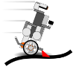

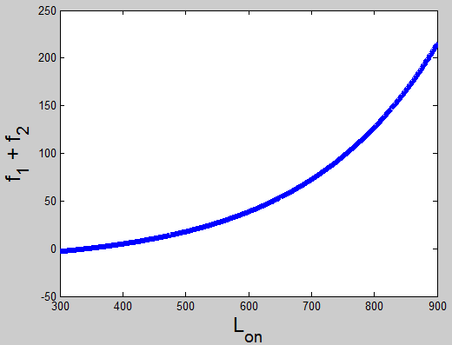



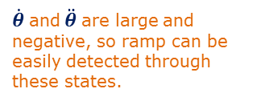


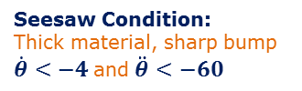





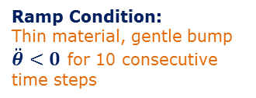






5. CONTROL ALGORITHM
Consists of 2 algorithms:
Light processing
Track mode control
$$φ$$
1: LINE TRACKING
2: PHI CONTROL
start
Phi control is used when:
There is no line
Line tracking is difficult
In case (2), phi control and line tracking are combined with a weighted average.
$$φ$$
$$φ$$
LP
Get . from states
$$φ_{desired}$$
A: LIGHT PROCESSING
Poll Light Sensor
$$u_{LEFT}$$
start
Read On
Proportional feedback control
$$\dot{φ}$$
entry:
turn light on
read $L_{on}$
$$u=K_{φ}∙(φ_{desired} −φ)$$
$$u_{RIGHT}$$
Read Off
Sensors
B: TRACK MODE CONTROL
$$u=100∙\frac{u}{V_{battery}}$$
Scale by battery voltage + saturate
$R$ = Wheel radius
$W$ = Distance between wheels
Track Mode:
entry:
turn light off
read $L_{off}$
TM
Determined based on distance and angle traveled by the robot.
$$u_{MAX}= 100 \\ u_{MIN}=−100$$
$$\dot{φ}=\frac{R}{W}\left(u_{RIGHT}−u_{LEFT}\right)$$
end
Poll Light Sensor
State Estimation
3: BALANCING
start
Balancer states do not perform any lateral ($φ$) correction, so only 5 out of 8 states are used.
Balancing commands can be added to line tracking or proportional $φ$ control.
Filter Light Values
$$x$$
PID Control Law:
From experimental data
$$θ, φ$$
Light sensor values
$${x= \left[ θ ψ \dot{θ} \dot{ψ} \ddot{θ} \right]}^{T}$$
Select Balancer states
$x=f_{1}\left(L_{on}\right)+f_{2}\left(L_{on}\right)−L_{off}$
Filter
Values
Find Track Zone
$$e=L_{desired}−L_{norm}$$
$f_{1}\left(L_{on}\right)=a_{1}e^{b_{1}L_{on}}$
$$L_{on}, L_{off}$$
$$u\left[t\right]= u_{P}[t]+u_{I}[t]+u_{D}[t]$$
$f_{2}\left(L_{on}\right)=a_{2}e^{b_{2}L_{on}}$
Lookup
Table
bias
$$u=K∙(x_{desired} −x)$$
Full-state feedback control
where $$u_{P}\left[t\right]= P∙e\left[t\right] \\ u_{I}\left[t\right]= I∙\int{e[t] dt} \\ u_{D}\left[t\right]= D∙\frac{d}{dt}\left(e_{filt}\left[t\right]\right)$$
$$e_{filt}\left[t\right]= e\left[t\right]∙N −$$ $u\left[t−1\right]∙\left(1−N\right)$
K is a 1x5 matrix
K is defined in each task and can be changed every time step.
Select Control Gains
$$u=100∙\frac{u}{V_{battery}}$$
$$L_{norm}$$
Scale by battery voltage + saturate
Control
Gains
$$u_{MAX}= 100 \\ u_{MIN}=−100$$
PWM commands lie in the range -100 to 100, and are replicated to both left and right wheels.
Lookup Table
Compute Forward and Turning Speeds
end
Black, Edge and White from calibration
4: RAMP DETECTION
1
$$v, ω$$
Approach:
Robot is moving toward the ramp and must detect it.
Ramp and Seesaw have different thicknesses, so their impact conditions are determined separately.
Impact conditions are found through experiment.
0.5
Balancing Algorithm
0
Edge
+ Bias
To Balancing Algorithm:
Impact:
Large backwards force upon contact with ramp.
TO DO
Black
White
Forward and turning speeds are reference states in balancing controller.
DETECT!
Bias value modified based on track zone
Line tracking is turned off during the Zone 4 shortcut.
$\dot{θ}$ and $\ddot{θ}$ are large and negative, so ramp can be easily detected through these states.
$$\dot{θ},\ddot{θ}$$
Ramp Condition:
Thin material, gentle bump
$\ddot{θ}<0$ for 10 consecutive time steps
Recovery:
Need to provide a large velocity command to overcome bump and gravity.
Seesaw Condition:
Thick material, sharp bump
$\dot{θ}<−4$and $\ddot{θ}<−60$

